Slide 1
Nuclear Fusion
Mech 3 rd year

Slide 2
Nuclear Fusion
Thermonuclear fusion is the process by which nuclei of low atomic weight such as hydrogen combine to form nuclei of higher atomic weight such as helium.
Two isotopes of hydrogen, deuterium (composed of a hydrogen nucleus containing one neutrons and one proton) and tritium (a hydrogen nucleus containing two neutrons and one proton), provide the most energetically favorable fusion reactants.
In the fusion process, some of the mass of the original nuclei is lost and transformed to energy in the form of high-energy particles.
Energy from fusion reactions is the most basic form of energy in the universe; our sun and all other stars produce energy through thermonuclear fusion reactions.

Slide 3
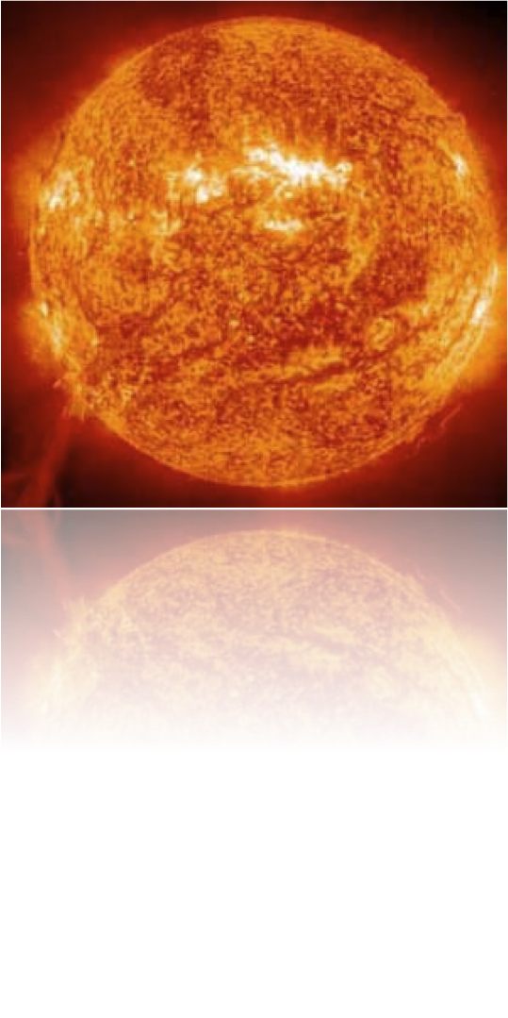
Nuclear Fusion Overview
Two nuclei fuse together to form one larger nucleus
Fusion occurs in the sun
Occurs in the stars
Initially, research failed
Nuclear weapon research renewed interest

Slide 4
The Science of Nuclear Fusion
Fusion in stars is mostly of hydrogen‏
  Electrically charged hydrogen atoms repel each other.
  The heat from stars speeds up hydrogen atoms
  Nuclei move so fast, they push through the repulsive electric force
Reaction creates radiant & thermal energy
Controlled Fusion uses two main elements
  Deuterium is found in sea water and can be extracted using sea water
  Tritium can be made from lithium
When the thermal energy output exceeds input, the equation is self-sustaining and called a thermonuclear reaction

Slide 5
1929
1939
1988
1993
Prediction using e=mc2, that energy from fusion is possible
Quantitative theory explaining fusion.
Japanese Tokomak
Princeton Generates 10 megawatts of power

Slide 6
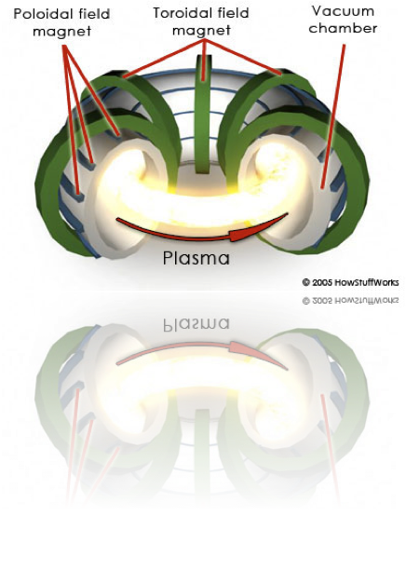
Same reaction as nuclear bomb
The reaction continually produces thermal energy
  Used to boil water and make steam
  2H is removed from water through isotope separation
  3H is not found naturally
  This can be done by surrounding the fusion chamber with lithium
The reactor, like a star, has to heat itself to millions of degrees
  Electric current passing through hydrogen fuel
Net energy gain requires:
  Highly compressed fuel
  Very high heat reactor
  Long enough for the reaction to occur
If fuel touches the wall, it cools instantly
  Fuel is held away from walls by electromagnetic force
Fusion Reactors

Slide 7
Fusion Applications
Power Plants
  2 Liters of Water + 250 Grams of rock provide enough resources for a one energy supply of a family
Nuclear Weapons
  500 times more powerful: Then first fusion weapons
  Different Process :Then Power Generation

Slide 8
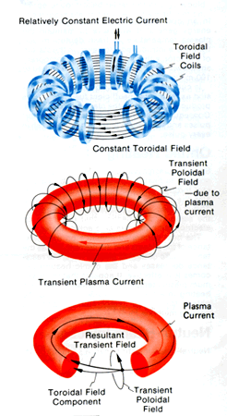
Challenges of Using Fusion
Fusion needs to be done at very high temperatures so that the elements become plasma.
Containing Plasma
  Three ways to heat and restrain plasma
    Gravity
    Inertia
    Magnetic
Notes:
Gravity: this is how most of the plasma in the universe is held together in stars, but this is cannot be reproduced by scientists
Inertia: one shoots many laser beams at the same exact time towards the elements in question creating an explosion outside of the chosen element which provides a reaction force (Newton's 2nd law)‏
Magnetic: By taking advantage of plasma's conductivity, one can use magnetic fields to contain the plasma.

Slide 9
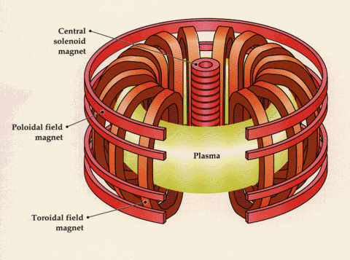
Tokomak Overview
Magnetic Plasma Containment
Two superimposed magnetic fields enclose the plasma
  Toroidal field generated by external coils
  The field of a flow in the plasma

Slide 10
Current Fusion Projects
ITER
Rochester Laser Lab for Energetics
produce 500 Megawatts of electricity for approximately 1000 seconds by the fusion of 0.5 grams of a deuterium/tritium mixture.
developing an understanding of how to create extreme states of matter using high-energy lasers and drivers

Slide 11
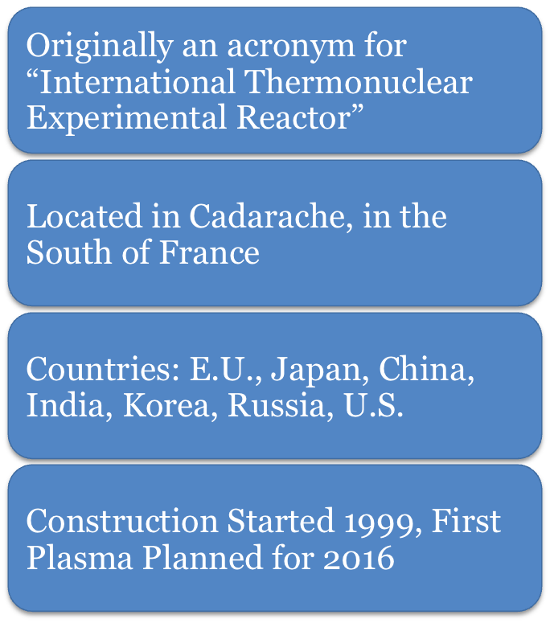
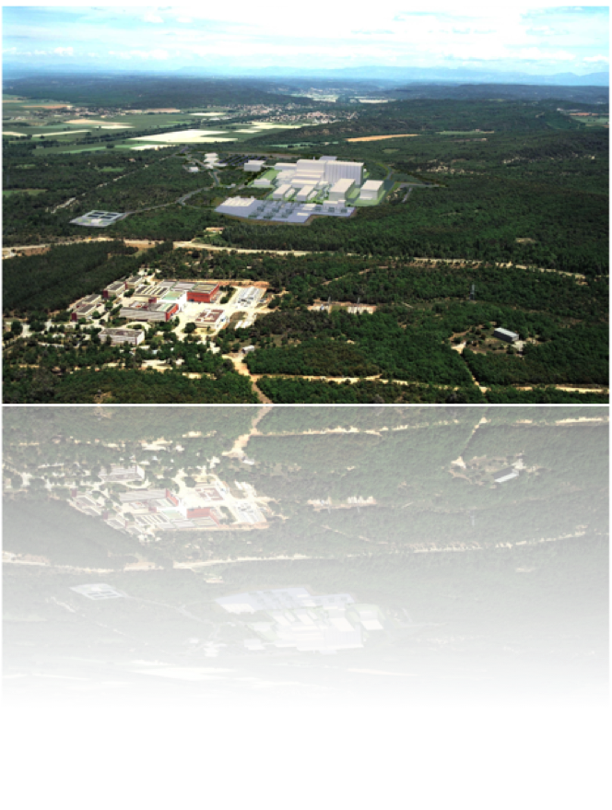
The ITER Project

Slide 12
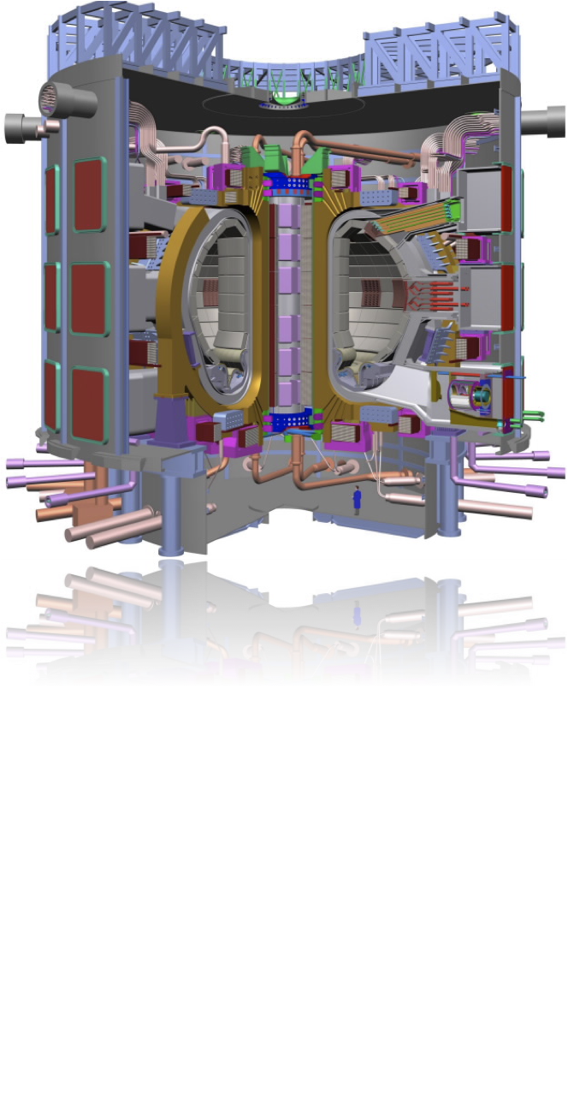
ITER: Goals of the Project
Prolonged fusion power production in a deuterium-tritium plasma
Scientific and technological feasibility of fusion power for peaceful purposes
  Ignite a ‘burning’ (self sustaining) plasma
    http://www.hiper-laser.org/fusion/storyboard.asp
  Develop technologies needed for future power plants

Slide 13
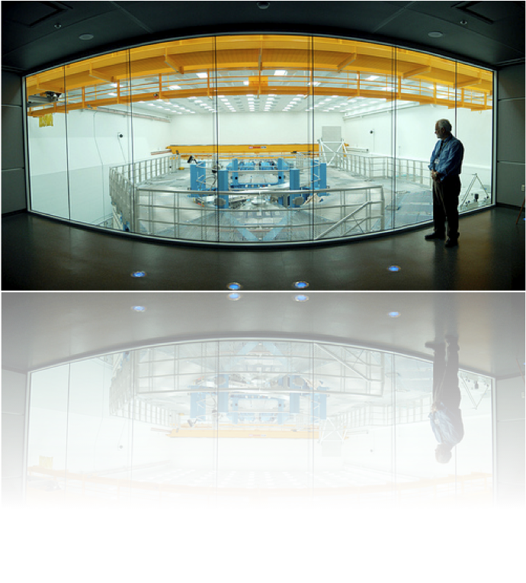
Rochester Laser Lab
Only inertial confinement fusion (ICF) research lab of type in U.S.
Supported by the National Nuclear Security
Fast ignition/advanced fusion schemes are being investigated
National Inertial Confinement Fusion Program
http://www.hiper-laser.org/fusion/fastignition.asp

Slide 14
Pros and Cons of Nuclear Fusion
Pros:
Clean energy source that produces no greenhouse gases.
Limitless amount of fuel available, deuterium and tritium easy to produce.
Fusion, unlike fission, does not involve a chain reaction, so the process can be stopped eliminating the risk of a meltdown.
Fusion does not produce nuclear waste, only the core of the reactor remains radioactive and only for 100 years.
Fusion has the potential to fuel the entire world for relatively low costs compared to today’s fuels.
Cons:
Fusion can only occur at extremely high temperatures (10-15 million K) making it difficult to contain.
The energy required to make fusion work could be greater than the output of energy by fusion itself.
Current research and experimentation is going to cost billions of dollars, money that could be invested in renewable green fuels.
Cold fusion may be the only way to make fusion efficient, and cold fusion has yet to been successfully developed.

Slide 15
Conclusion
New energy sources are necessary
  Oil reserves may run out in 50 to 100 years
  Greenhouse emissions
Short-term, nuclear fission is a better solution
  reactors
Long-run, fusion may be viable
  Safe production of large amounts of energy

